Slide 1

Setting Up a Web and DNS Server
Jasmine Roberts
CTEC-435-102FALL2024 Unix Administration
November 25, 2024

Slide 2
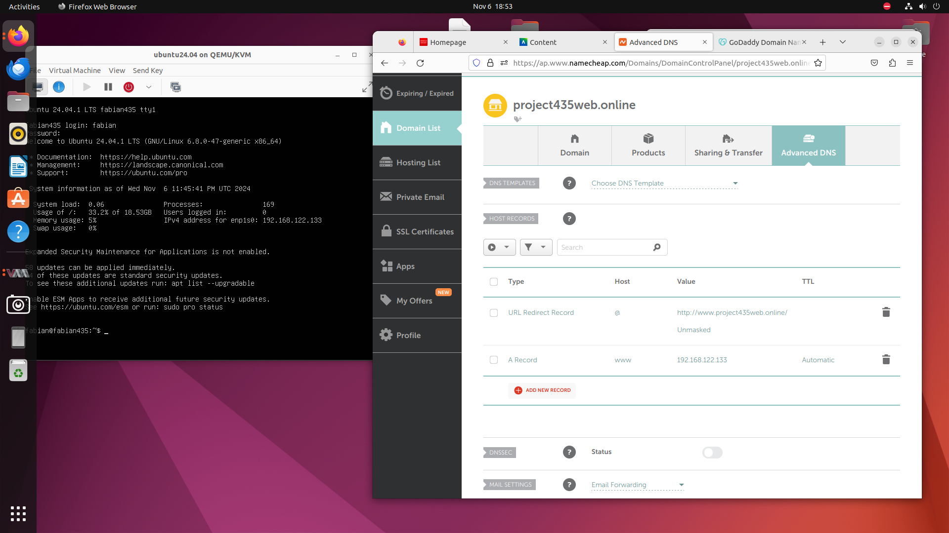
Acquiring a Domain Name:
project435web.online
Registered a domain name which can be used with DNS and web server
Updated DNS records for the domain registrar for the servers IP address
Created a record for the domain

Slide 3
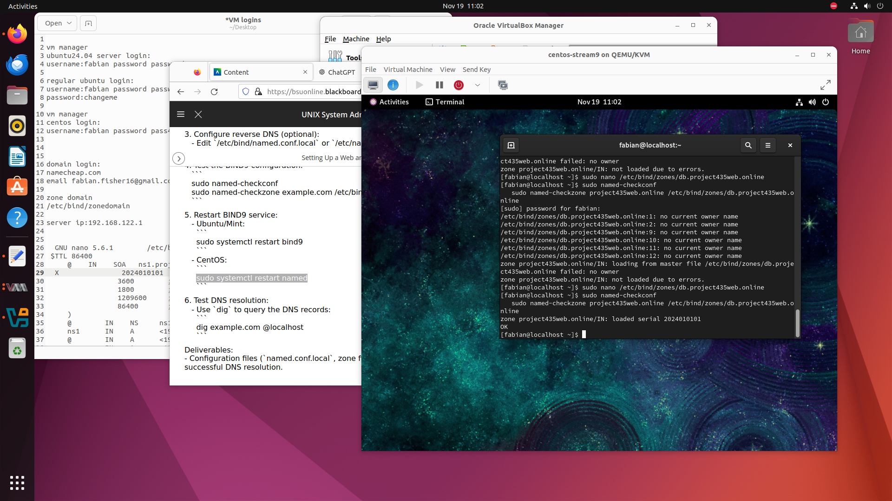
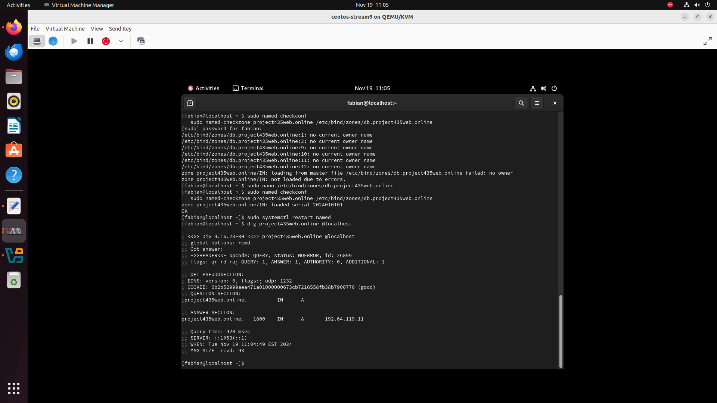
Configured BIND9 as an authoritative DNS server
Install BIND9 on the server using CENTOS-stream9
Configured BIND9 as a :
DNS Server
Configured its zone files
Created a zone file for the domain

Slide 4
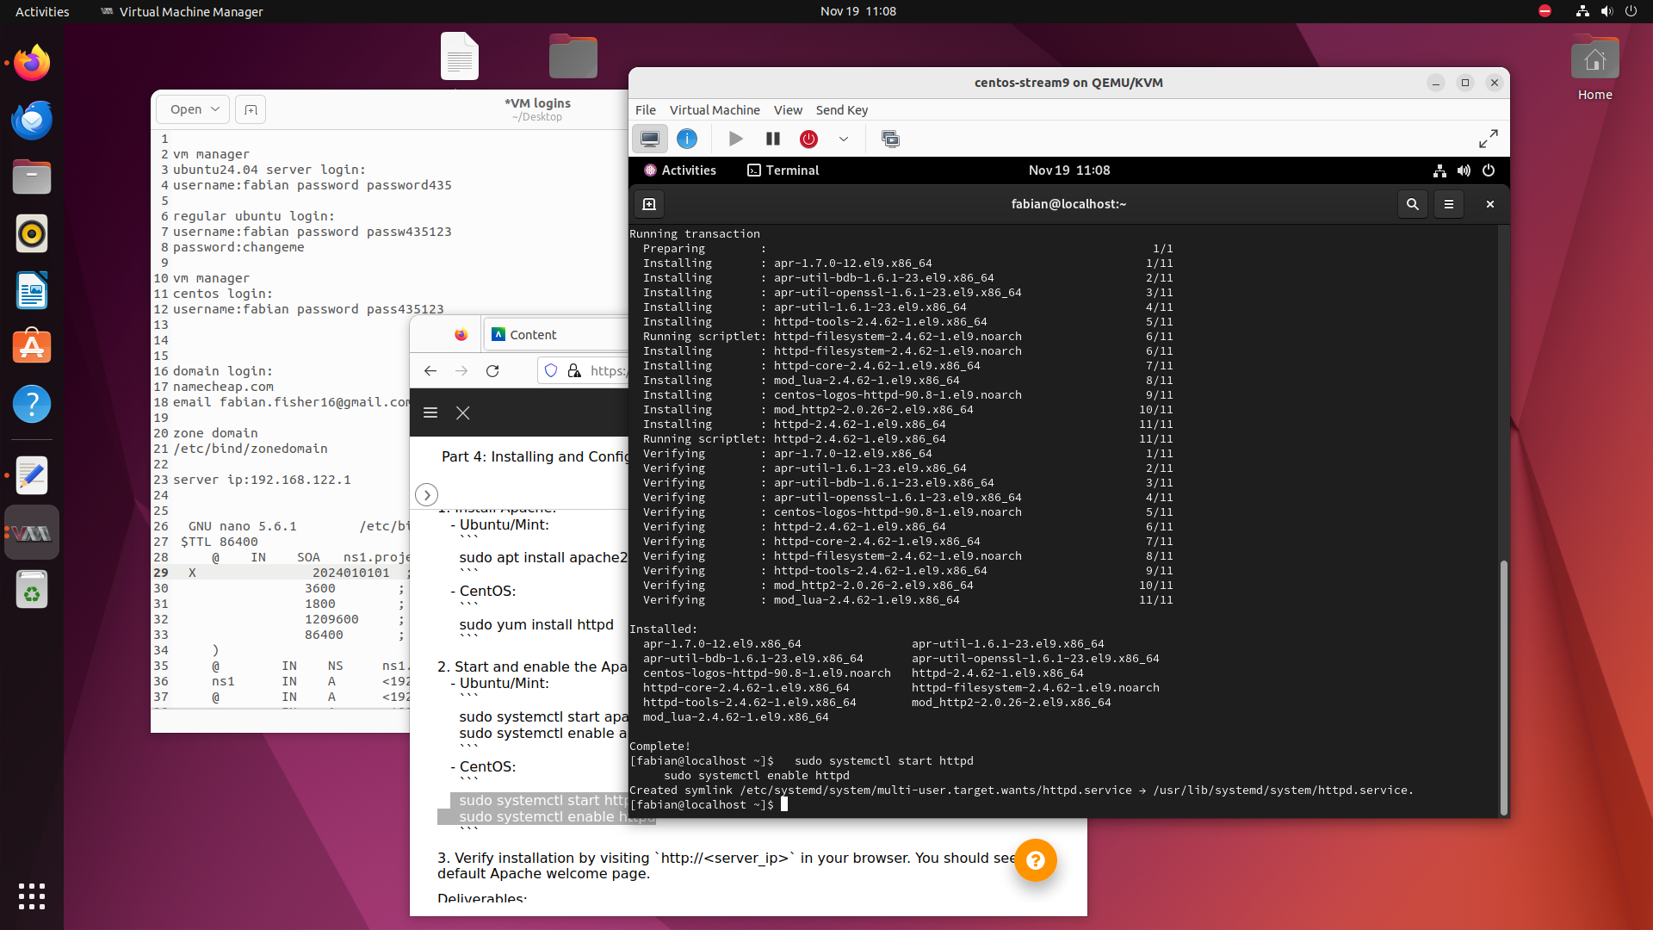
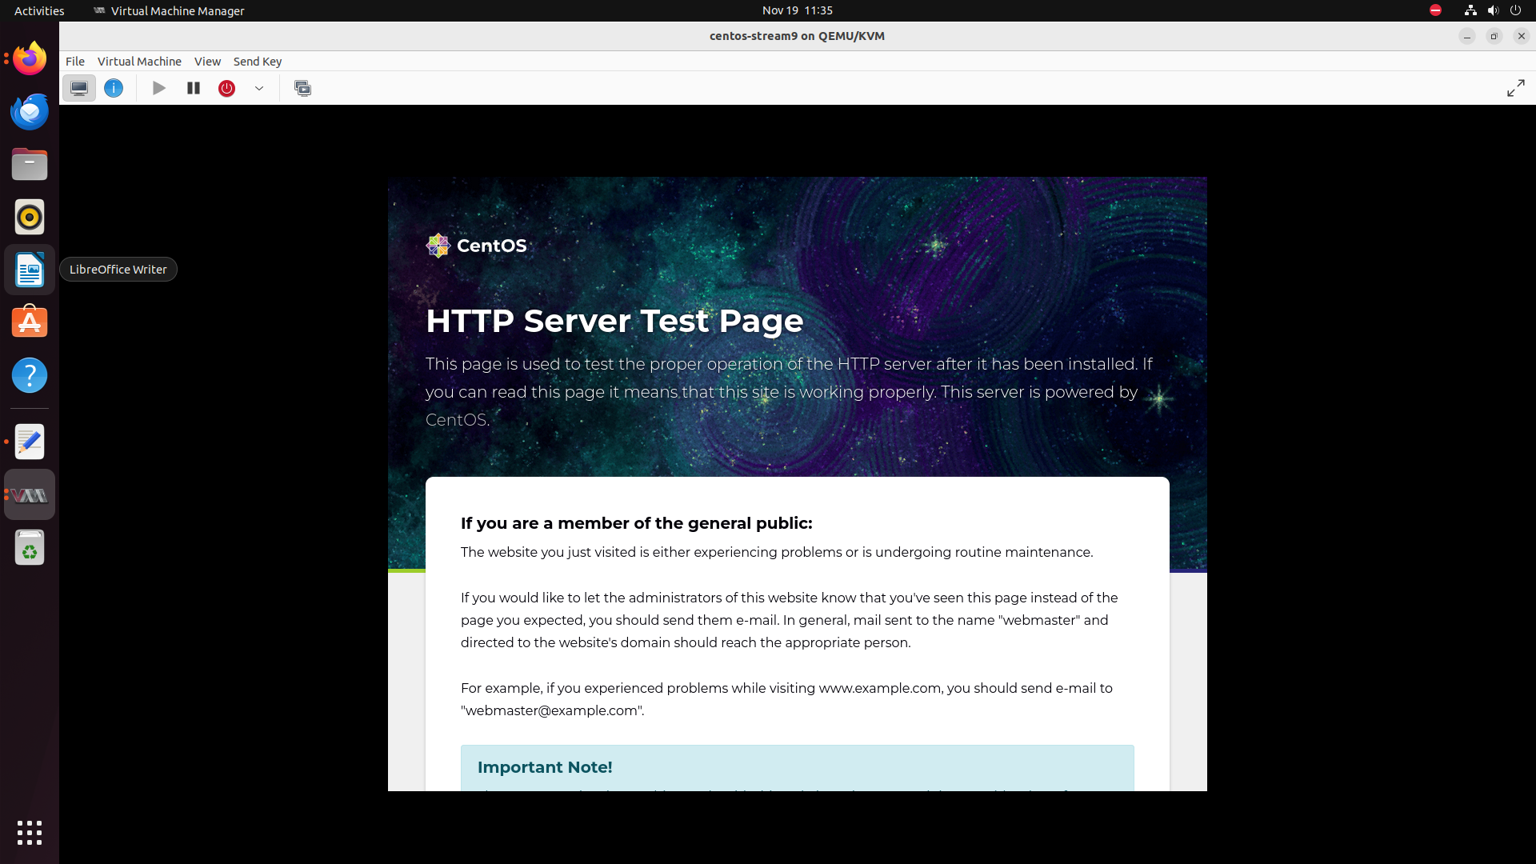
Installing and Configuring Apache Web Server
Installed and configured Apache as a web server

Slide 5
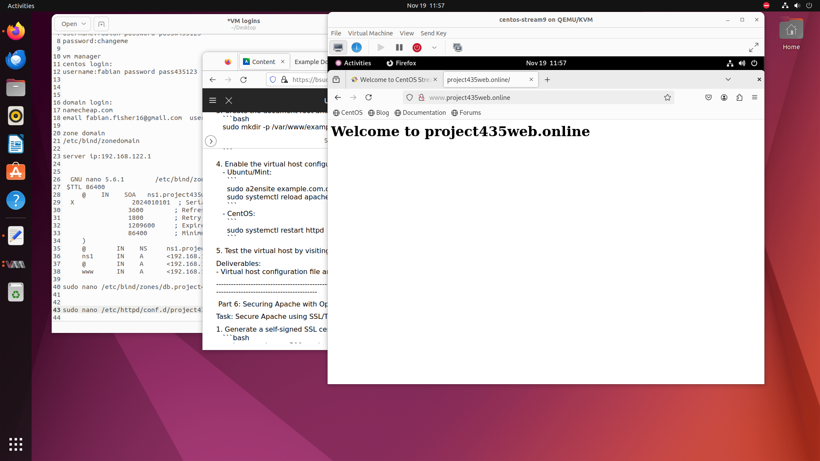
Securing Apache with SSL and Digital Certificates
Created a self-signed SSL certificate using OpenSSL.
Modified the virtual host configuration file for project435web.online to enable SSL, ensuring the server listens on port 443 and uses the appropriate SSL certificate and key files.
This will allow the website to be accessible via a web browser using its domain name.

Slide 6
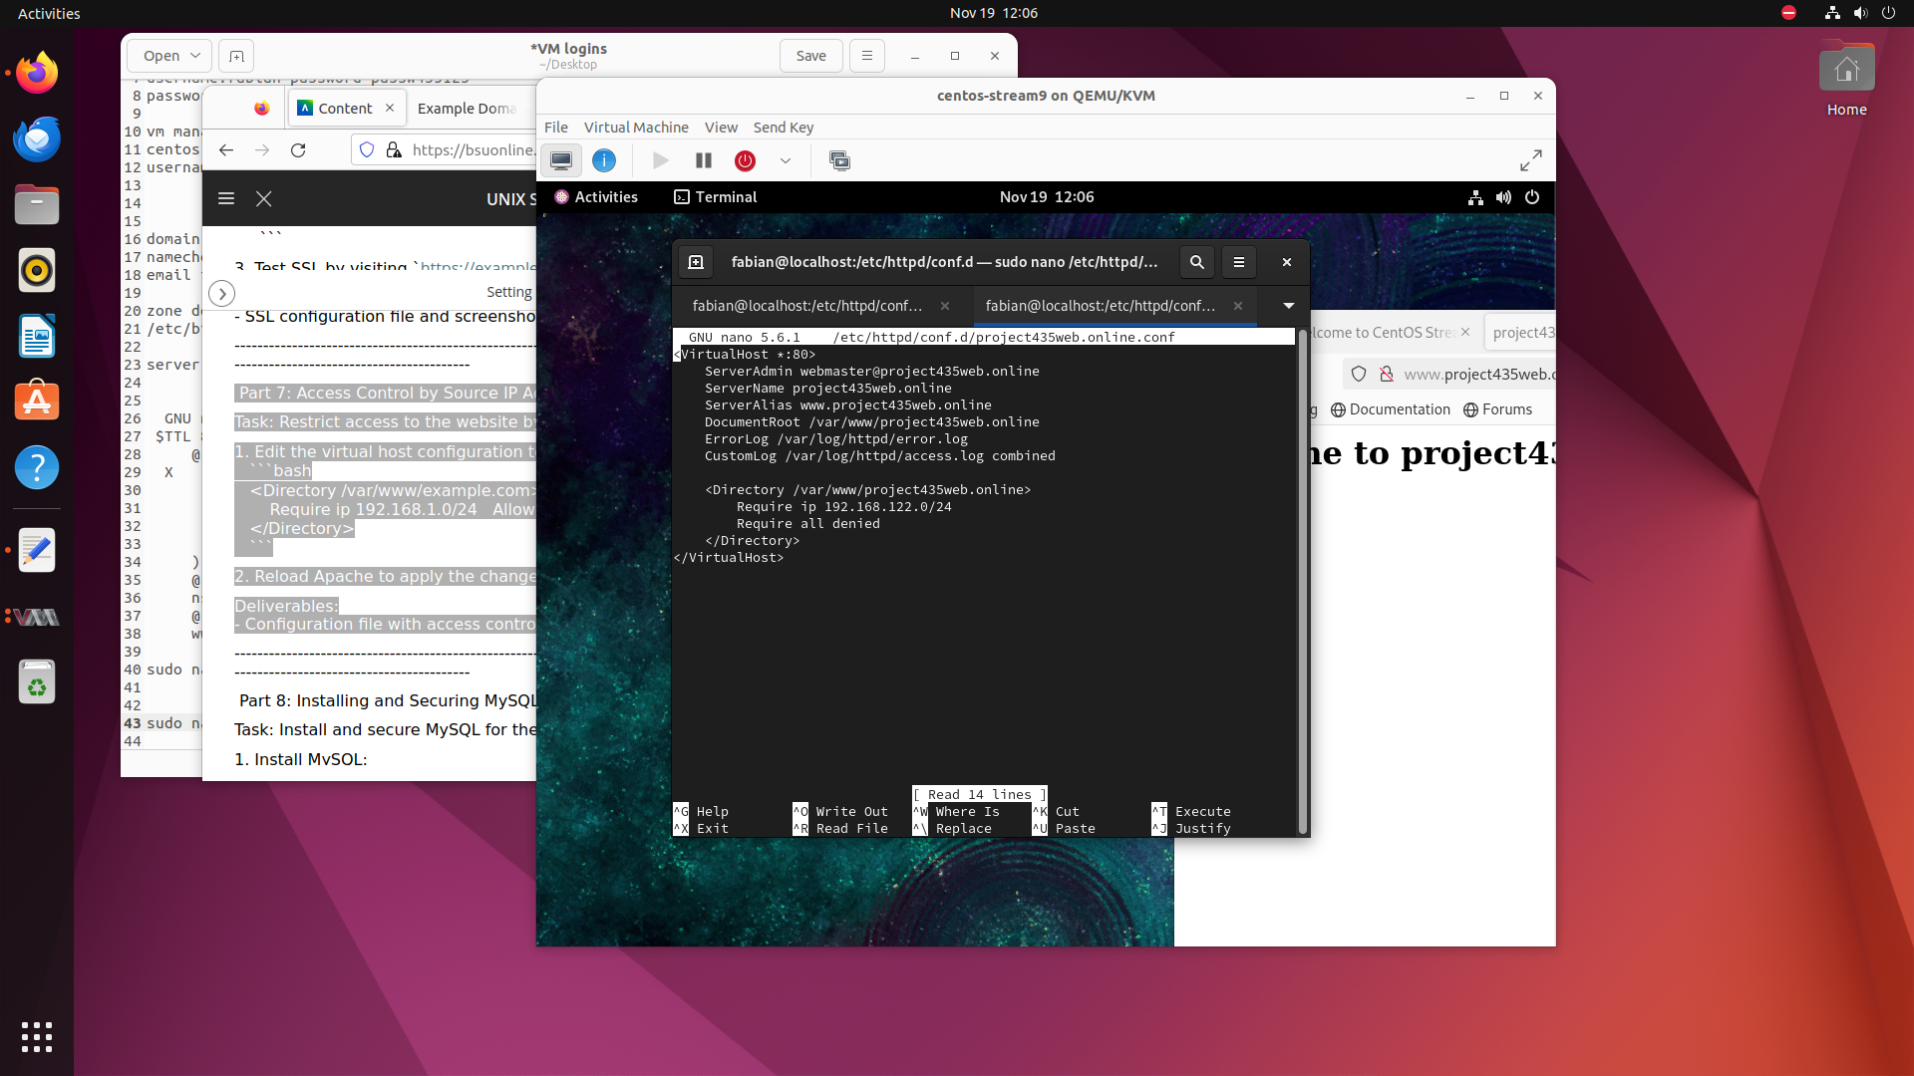
Access Control by Source IP Address
Configuring Apache to restrict access, allowing only specific IP ranges to access the web server.

Slide 7
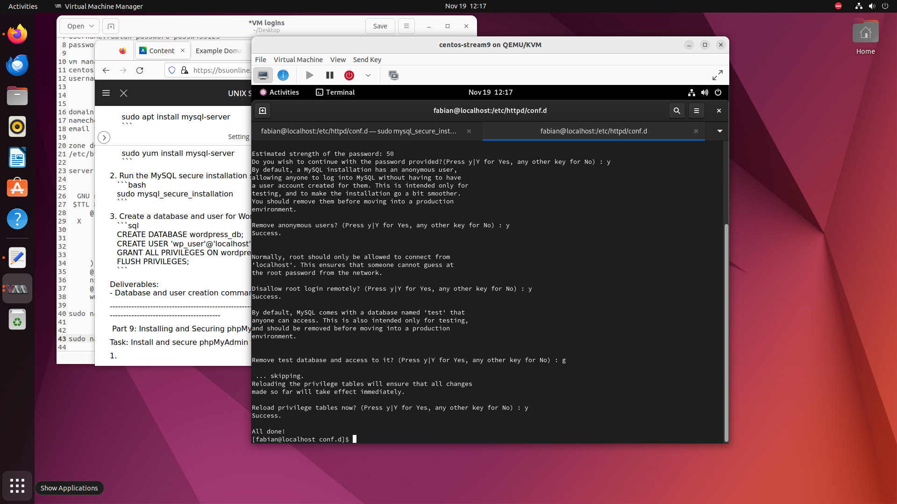
Installing and Securing MySQL Server
Install MySQL on CentOS.
Run the mysql_secure_installation script to remove insecure defaults, disable anonymous users, and enforce strong password policies.
Create a MySQL database and user for WordPress, granting the user the necessary privileges to manage the WordPress database.

Slide 8
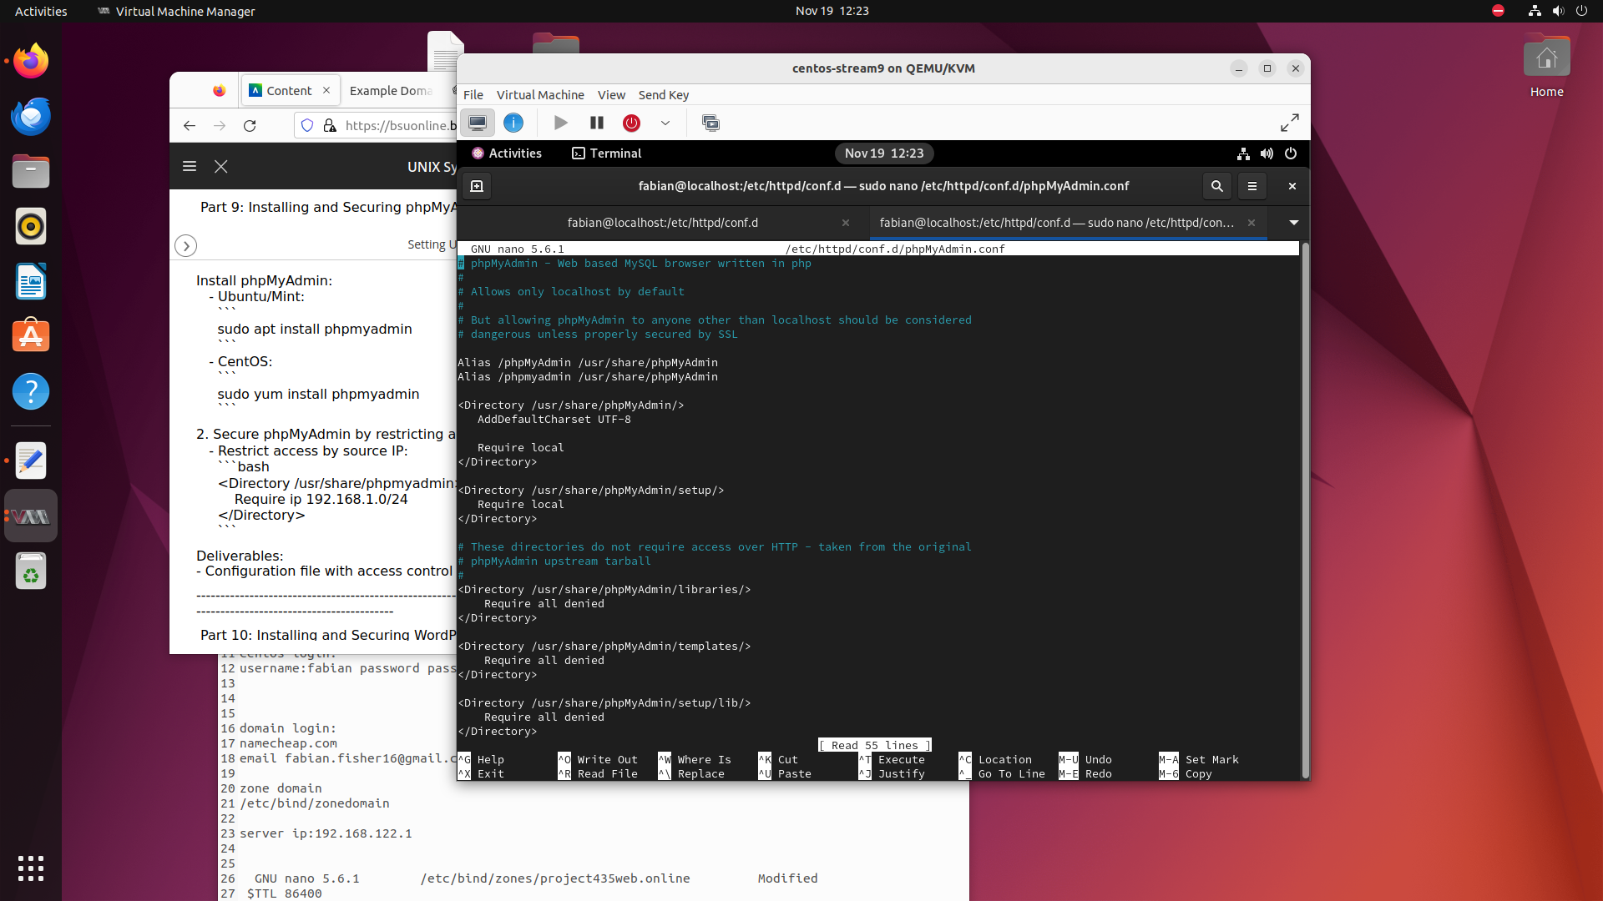
Installing and Securing phpMyAdmin
Installing phpMyAdmin and configuring access controls to limit usage to authorized IP addresses.

Slide 9
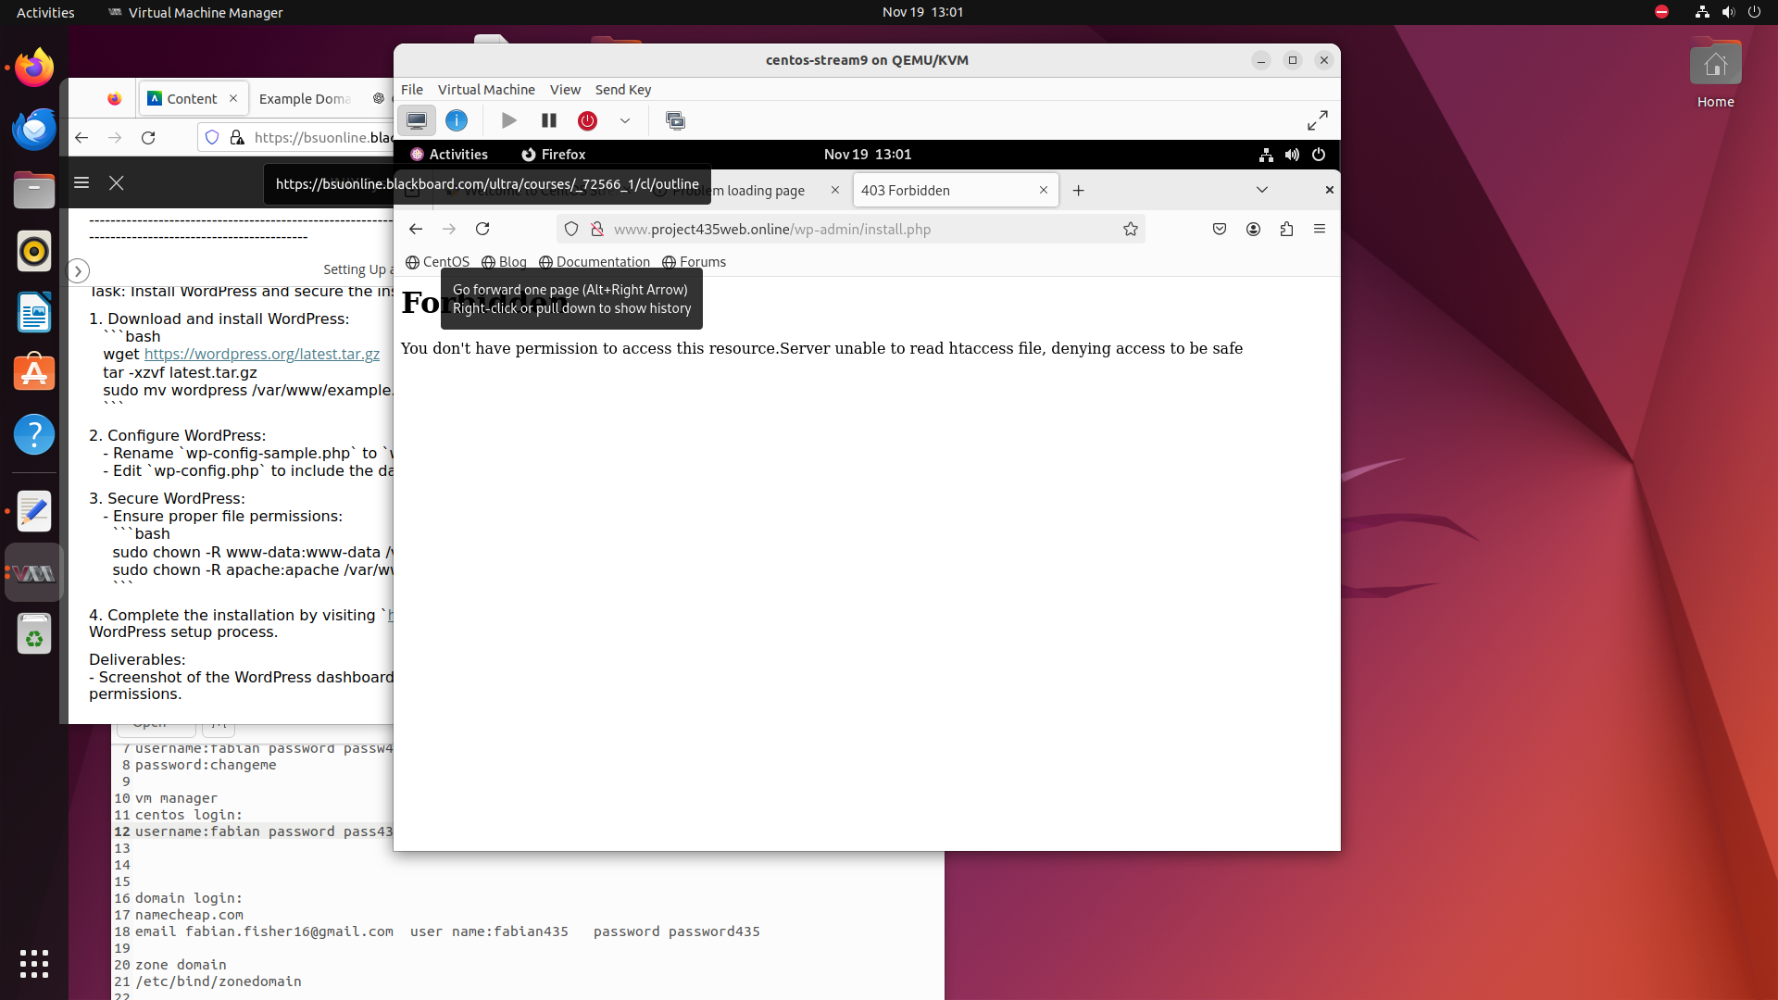
Installing and Securing WordPress
Install WordPress by downloading the latest version, extracting the files, and configuring the database connection.
Set appropriate file permissions to ensure that critical directories are not writable by unauthorized users.
Complete the WordPress setup by visiting the WordPress installation page and configuring the site.

Slide 10

Lessons Learned
We learned how to:
Acquire a domain name
Set up a DNS Server
Set up a web server
Configured BIND9 DNS Server
Zone Files for our domain
Installing and Configuring Apache
Virtual Hosting
Digital Certificates
Access Control by source IP
Installing and Securing MySQL Server
phpMyAdmin
Installing and Securing WordPress

Slide 11
THE END

